Slide 1
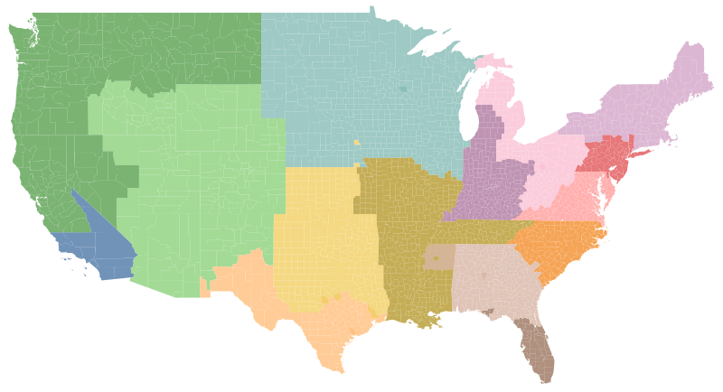
GE Healthcare Financial Services
Sales Coverage
NorthEast
Matt Salamon
Matthew.salamon@gehealthcare.com
203-241-8600
West Central
Pacific NW
Mary Ban
Mary.ban@gehealthcare.com
262-794-7578
Heartland
New
England
Lake
Erie
NY-Philly
Rocky
Mountain
Ohio
Valley
Chesapeake
Gateway
Dallas
Carolinas
Southwest
Atlanta
Houston
South
Florida
Jeff Andrews
Jeffrey.andrews@gehealthcare.com
770-630-5742

